Slide 1

Arithmetic Circuits

Slide 2
Half Adder
A | B | Sum | Carry
0 | 0 | 0 | 0
0 | 1 | 1 | 0
1 | 0 | 1 | 0
1 | 1 | 0 | 1

Slide 3
Half Adder

Slide 4
Full Adder
A | B | Cin | Sum | Cout
0 | 0 | 0 | 0 | 0
0 | 0 | 1 | 1 | 0
0 | 1 | 0 | 1 | 0
0 | 1 | 1 | 0 | 1
1 | 0 | 0 | 1 | 0
1 | 0 | 1 | 0 | 1
1 | 1 | 0 | 0 | 1
1 | 1 | 1 | 1 | 1

Slide 5
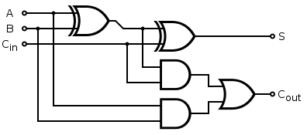
Full Adder

Slide 6
Implementing a Full adder using two half adders

Slide 7
Parallel Binary Adder

Slide 8
Parallel Binary adder
Two Numbers X & Y
Each number is represented using 6 bits.
[X]=X_{o}X₁X₂X₃X₄X₅
[Y]=Y_{o}Y₁Y₂Y₃Y₄Y₅

Slide 9
Complete Parallel Adder With Registers
D Flip-flops are used to save a single bit
A number of D flip-flops are connected in a way to form the binary number, where each bit of that number is saved in a single D flip-flop.

Slide 10
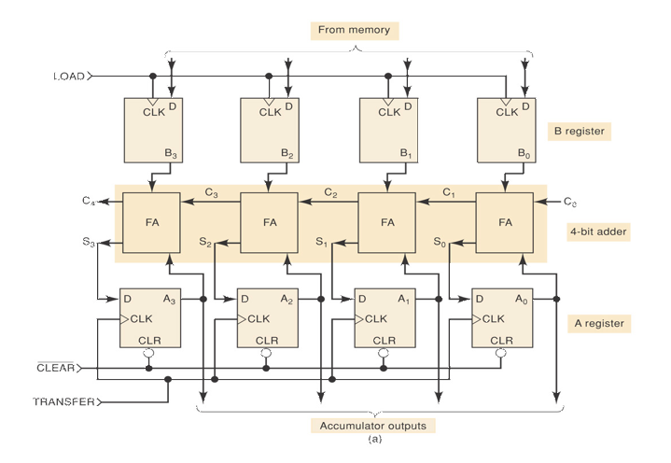

Slide 11
Example: Sequence of operations in Adding
1001 and 0101
1) [A] = 0000. A CLEAR pulse is applied to CLR of each FF on register A at t₁.
2) [M] → [B]. The first binary number 1001 is transferred from memory to B register on the PGT of the LOAD pulse at t₂.
3) [S] → [A]. With [B] = 1001 and [A] = 0000, the full adders produce a sum of 1001 which is transferred to A register on the PGT of the TRANSFER pulse at t₃. This makes [A] = 1001.
4) [M] → [B]. The second binary number 0101 is transferred from memory to B register on the PGT of the second LOAD pulse at t₄. This makes [B] = 0101.
5) [S] → [A]. With [B] = 0101 and [A] = 1001, the full adders produce a sum of 1110 which is transferred to A register on the PGT of the second TRANSFER pulse at t₅. This makes [A] = 1110.

Slide 12
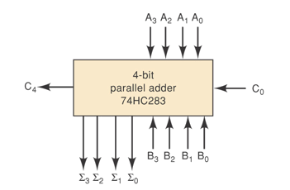
Integrated Circuit Parallel Adder
( IC Parallel Adder )
4- Bits adder

Slide 13
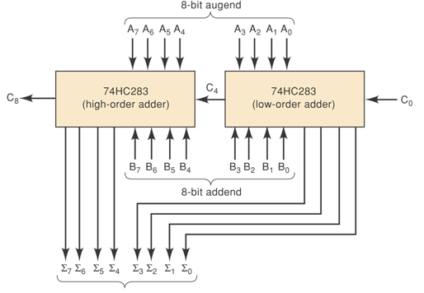
8 – Bit IC Parallel Adder

Slide 14
BCD Adder

Slide 15
BCD Adder
When the sum of two digits is less than or equal to 9 then the ordinary 4-bit adder can be used
But if the sum of two digits is greater than 9 then a correction must be added “I.e adding 0110”
We need to design a circuit that is capable of doing the correct addition

Slide 16
BCD Adder
The cases where the sum of two 4-bit numbers is greater than 9 are in the following table:
S4 | S₃ | S₂ | S₁ | S₀
0 | 1 | 0 | 1 | 0 | 10
0 | 1 | 0 | 1 | 1 | 11
0 | 1 | 1 | 0 | 0 | 12
0 | 1 | 1 | 0 | 1 | 13
0 | 1 | 1 | 1 | 0 | 14
0 | 1 | 1 | 1 | 1 | 15
1 | 0 | 0 | 0 | 0 | 16
1 | 0 | 0 | 0 | 1 | 17
1 | 0 | 0 | 1 | 0 | 18

Slide 17
BCD Adder
Whenever S₄=1 (sums greater than 15)
Whenever S₃=1 and either S₂ or S₁ or both are 1 (sums 10 to 15)
The previous table can be expressed as:
X = S₄ + S₃ ( S₂ + S₁)
So, whenever X = 1 we should add a correction of 0110 to the sum.

Slide 18
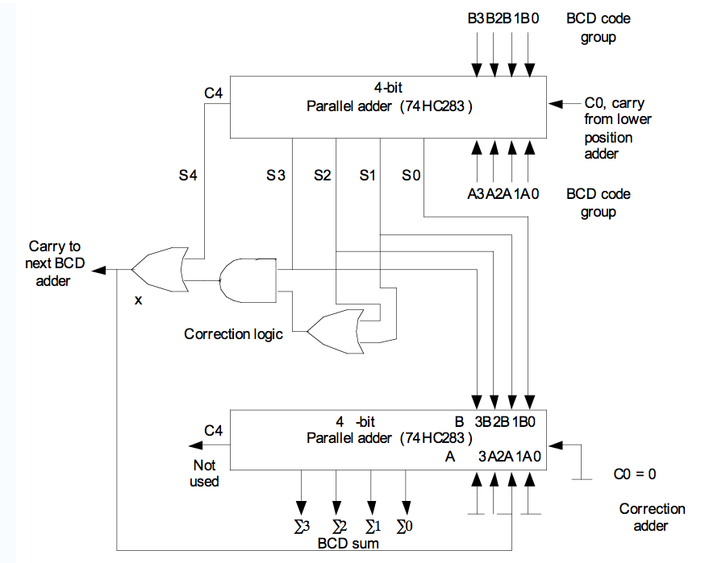
Inputs:[A]=0101, [B]= 0011, C_{o}=0
0011
0101
0 1 0 0 0
0
0
0
1000
1
1 0 0 0
0000

Slide 19
Inputs:[A]=0111, [B]= 0110, C_{o}=0
0110
0111
0 1 1 0 1
1
1
1
1101
1
0 0 1 1
0110

Slide 20
Cascading BCD Adders
The previous circuit is used for adding two decimal digits only. That is, “ 7 + 6 = 13”.
For adding numbers with several digits, a separate BCD adder for each digit position must be used.
For example:
2 4 7
5 3 8 +
--------------------
?
BCD Adder
BCD Adder
BCD Adder

Slide 21
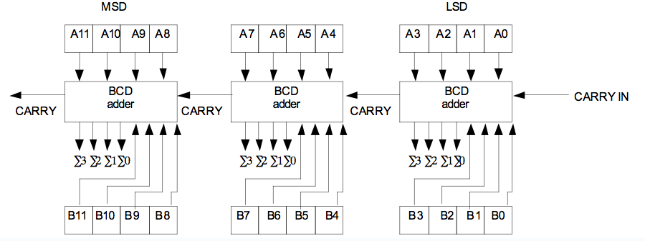
Cascading BCD Adders

Slide 22
Example
Determine the inputs and the outputs when the above circuit is used to add 538 to 247. Assume a CARRY IN = 0
Solution:
  Represent the decimal numbers in BCD
    247 = 0010 0100 0111
    538 = 0101 0011 1000
    Put these numbers in registers [A] and [B]
    [A] = 0010 0100 0111
    [B] = 0101 0011 1000

Slide 23
Example
0 0 1 0
0 1 0 0
0 1 1 1
0
0
1
0
0111
1000
0101
0 1 0 1
0 0 1 1
1 0 0 0

